Slide 1
UK farmers waste between 10% and 16% of their crops annually
Source: Feedback, an environmental charity
Over 170,000 tonnes of food is wasted in the fresh produce supply chain every year
Source: WRAP (Waste and Resources Action Programme)

Slide 2
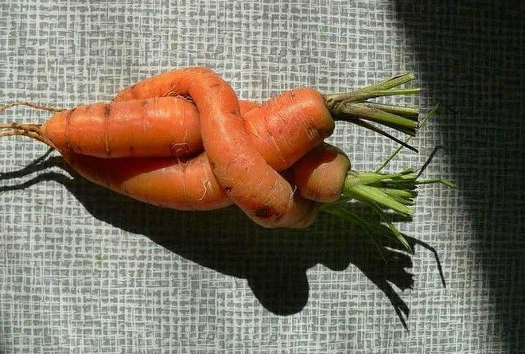
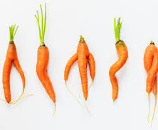
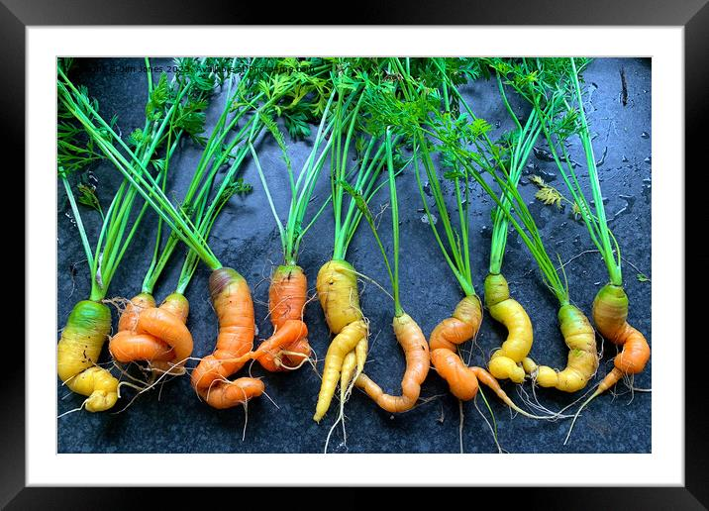

Slide 3



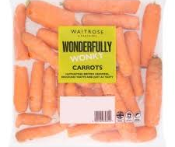



Slide 4

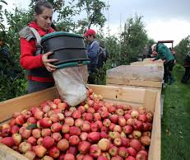

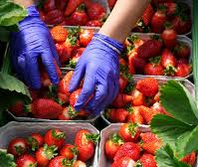
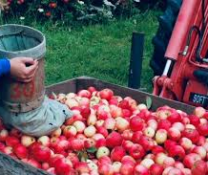


Slide 5
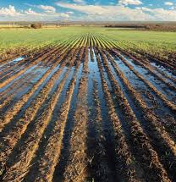


Slide 6


Slide 7
