Slide 1

Welcome

Slide 2
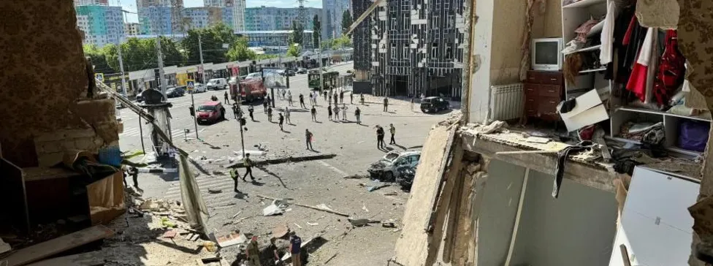
Kharkiv, Ukraine

Slide 3
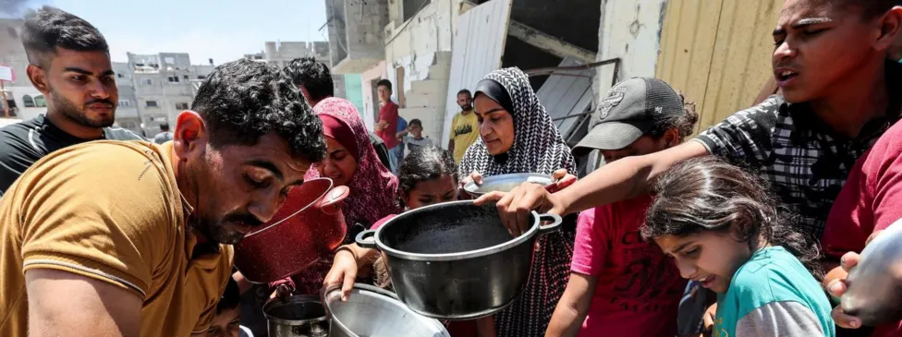
World Food Programme in Gaza

Slide 4
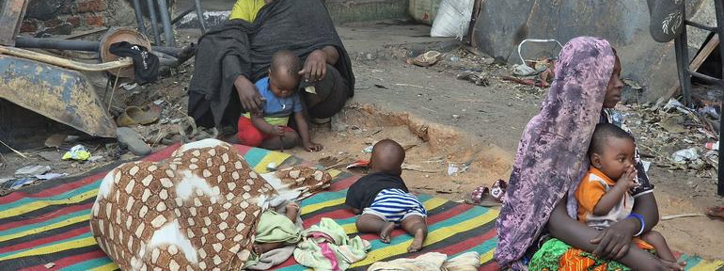
Sudan

Slide 5
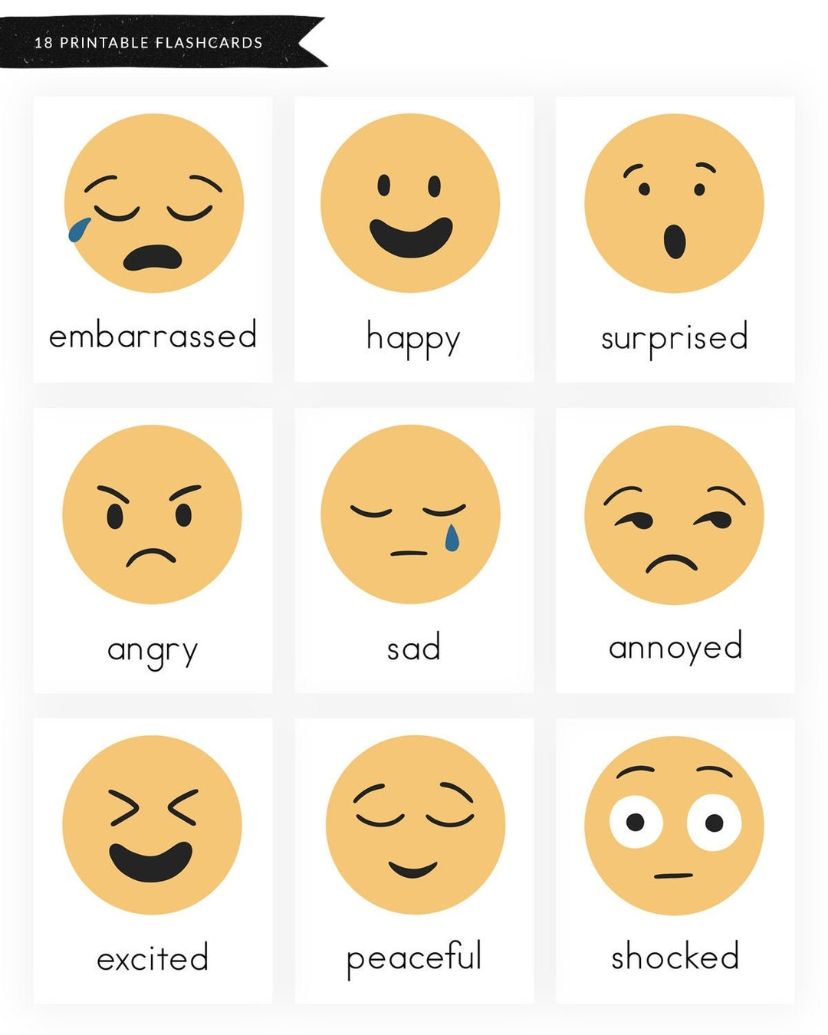
How do you feel when you connect with news of suffering?

Slide 6

May _____ be happy
May _____ be healthy
May ______ be safe
May ______ be at ease
Ourselves
Someone we love
Someone we feel neutral about
Someone we have a difficult relationship with
All beings

Slide 7
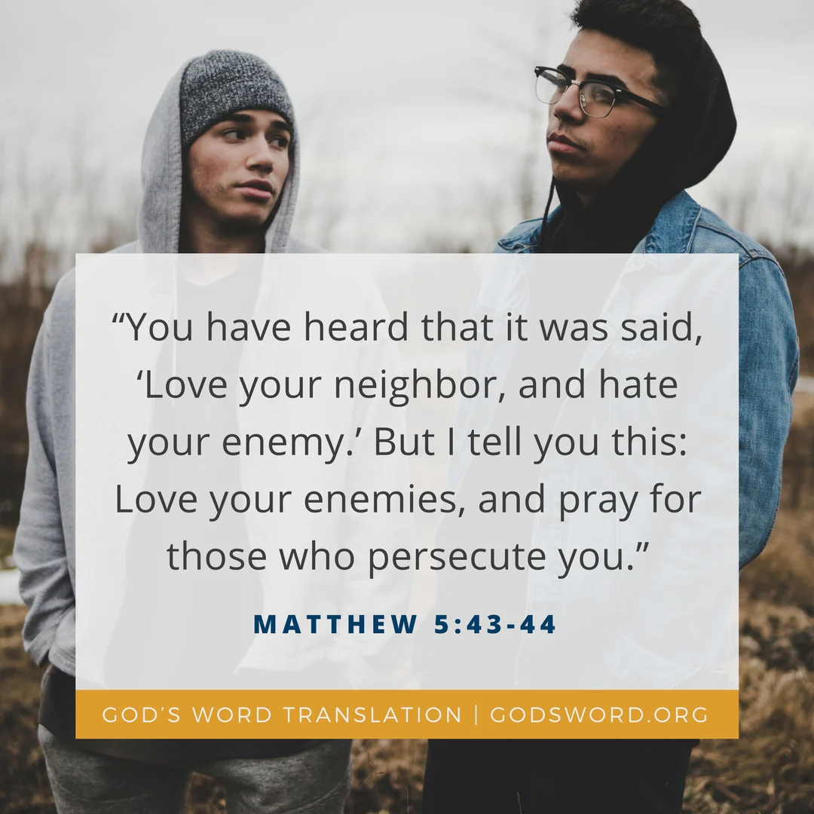

Slide 8
May _____ be happy
May _____ be healthy
May ______ be safe
May ______ be at ease
Ourselves
Someone we love
Someone we feel neutral about
Someone we have a difficult relationship with
All beings

