Slide 1

Welcome

Slide 2
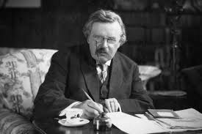
‘There are two ways to get enough. One is to continue to accumulate more and more. The other is to desire less.’
G. K. Chesterton

Slide 3

‘Why spend money on what is not bread, and your labour on what does not satisfy? Listen, listen to me, and eat what is good, and you will delight in the richest of fare.’ (Isaiah 55.2)

